Slide 1
Rotational Analysis of an
Electronic Transition of CuOH
Observed with Intracavity Laser spectroscopy
Jack C. Harms, Leah C. O’Brien*, & James J. O’Brien
Department of Chemistry and Biochemistry, University of Missouri-St. Louis
*Department of Chemistry, Southern Illinois University Edwardsville

Slide 2
Previous Experimental Studies
Trkula & Harris (1983)
  Rotationally Analyzed Chemiluminescence and LIF Spectra of CuOH and CuOD
  (1,0) & (0,1) rotational subbands of B ¹A" – X ¹A' transition at 18,400 cm⁻¹
Jarman, Fernando, & Bernath
  Rotationally Analyzed LIF Spectra of CuOH & CuOD
  Additional K-bands of the B – X transition (1990)
    Reported unanalyzed transition at 19,040 cm⁻¹ (C ¹A' – X ¹A' transition)
  A ¹A' – X ¹A' transition at 15,900 cm⁻¹ (1991)
    Reported unanalyzed transition at 15,060 cm⁻¹
Whitham, Ozeki, & Saito
  mm wave spectrum of CuOH in X ¹A' state (1999)
  mm wave spectrum of CuOD in X ¹A' state (2000)
Tao, Mukarakate, & Reid (2007)
  Vibrational analysis and fluorescence lifetime determination on B – X transition from SVL Fluorescence measurements
Wang & Steimle (2011)
  Measured dipole moment of X ¹A' state using Stark spectroscopy of B – X transition
˜
˜
˜
˜
˜
˜
˜
˜
˜
˜
˜
˜
˜
˜
˜

Slide 3
Computational Investigation
Cheng, Fortenberry, & Deyonker (2017)
  Calculation of ground state spectroscopic parameters for CuCN, CuOH, & CuCCH using QFF method
Wang et al. (2005)
  Used several computational methods to investigate lowest three singlet states of CuOH
    Results generally agreed with experimental values for ground state, but significant deviations from experimental rotational parameters for excited states
    Suggested that A ¹A' state actually triplet
7 additional studies from 1984 – 2003, most investigating only the ground state of CuOH
In Summary: excited states of CuOH not thoroughly investigated computationally
˜
Notes:
QFF-Quartic Force Field

Slide 4
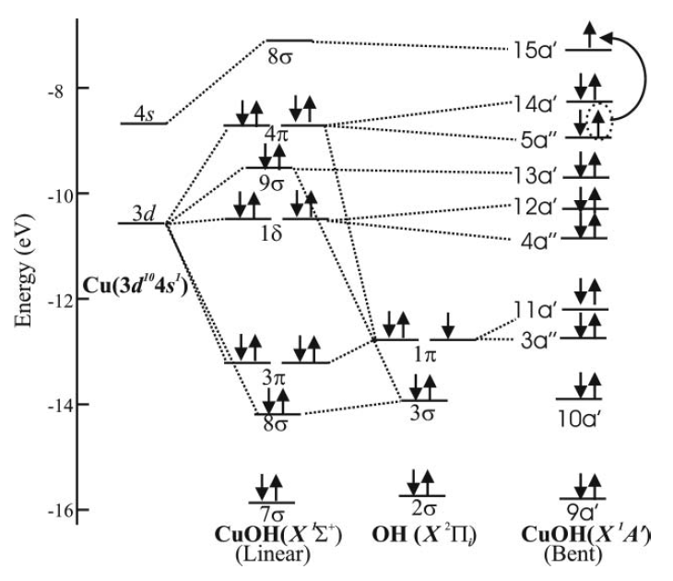

Energy Level Diagram
F. Wang & T. C. Steimle, J. Chem. Phys., 134, 014303 (2011)
Notes:
d

Slide 5
Experimental Conditions
Coherent VerdiTM Pumped Dye Laser:
  DCM Laser Dye
  Tuned with xyz translatable wedge
  Operates from 14,500 to 16,500 cm⁻¹ using 0.50 - 1.50 W Pump Power
CuOH:
  500 mtorr O₂, trace H₂
  0.40 A RF Discharge (110 V)
CuOD:
  375 mtorr O₂/D₂ atmosphere (80:20 O₂:D₂)
  0.45 A RF Discharge (160 V)
  Both:
    130 mm Cu Cathode, t_{g} 300 μsec, L_{eff} ~10 km
  Wavelength Calibration:
    Extracavity I₂ cell
    Reference data of Salami & Ross [J. Mol. Spec., 223, 157 (2005)]
    Deviations typically less than ±0.002 cm⁻¹

Slide 6
Instrument Schematic
O₂/H₂(D₂)

Slide 7
Description of Observed Spectra
P-, Q-, & R-branches with origin at 15,155 cm⁻¹ for CuOH and 15,128 cm⁻¹ for CuOD
  Clear ⁶³Cu/⁶⁵Cu isotope splitting in P & R branches, Q-branch too congested to identify ⁶⁵CuOH features
Clear Q- & R-branches and less clear P-branch with origin at 15,093 cm⁻¹ for CuOH and 15,099 cm⁻¹ for CuOD
  Spectral region to the red of the Q-branch is quite congested
Two additional Q-branches with origins at 15,065 cm⁻¹ & 15,059 cm⁻¹ for CuOH and 15,080 cm⁻¹ & 15,072 cm⁻¹ for CuOD

Slide 8
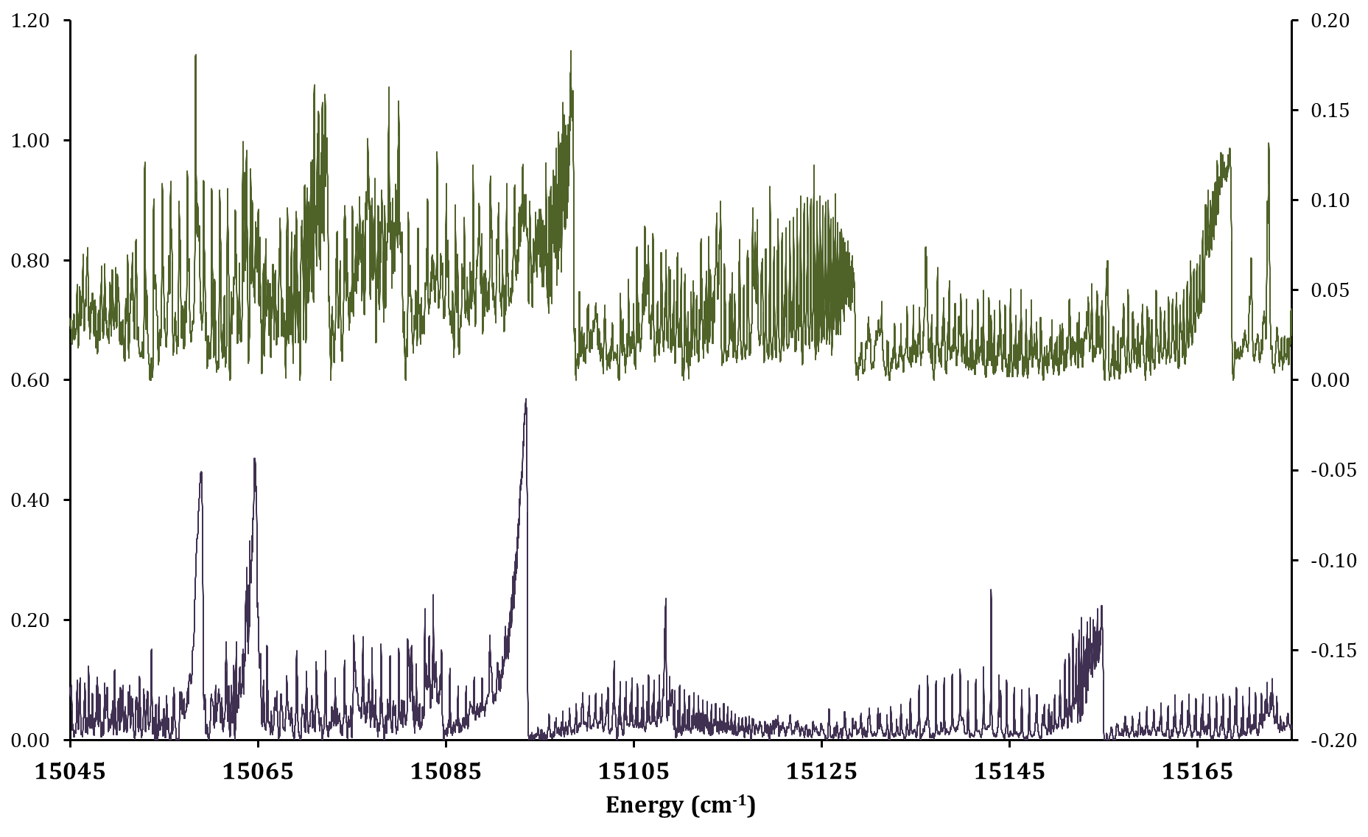
Experimental Data
CuOD
Absorbance
CuOH
Absorbance

Slide 9
Fitting with PGOPHER
Ground state rotational constants for ⁶³CuOH, ⁶⁵CuOH, and ⁶³CuOD held fixed to values from Whitham, Ozeki, & Saito
Excited state set as ¹A" state
⁶³CuOH (210 transitions)
  P-, Q-, & R-branches for (1,0) & (0,1) subbands, P- & R- for (1,2) subband
  Only lines J' < 21 for K' = 1
⁶³CuOD (353 transitions)
  P-, Q-, & R-branches for (1,0), (2,1), & (0,1) subbands, P- & R-branches for (1,2) & (2,3) subbands
⁶⁵CuOH (175 Transitions)
  P- & R-branches for (1,0) & (0,1) subbands
    Other branches/subbands insufficiently resolved or too weak to be identified definitively
⁶⁵CuOD (0 transitions)
  Not all branches sufficiently resolved and no mm wave data for reference

Slide 10
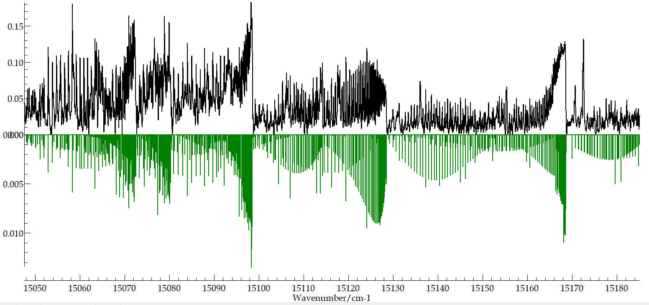
CuOD Spectrum with PGOPHER Simulation
(2, 3) subband
(0, 1) subband
(2, 1) subband
(1, 2) subband
(1, 0) subband
Absorbance

Slide 11
Molecular Constants for [15.1] A" State of CuOH
b

Slide 12
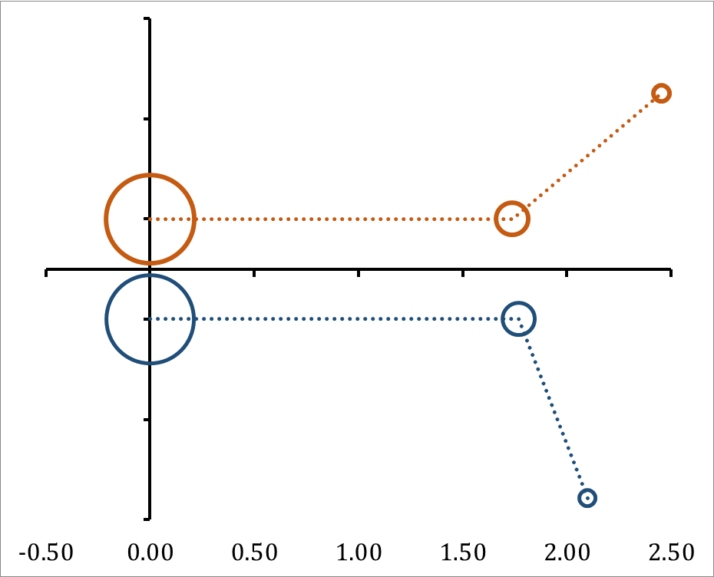
CuOH Structure
1.00
0.50
[15.1] A"
˜
X ¹A'
0.50
Å
1.00

Slide 13
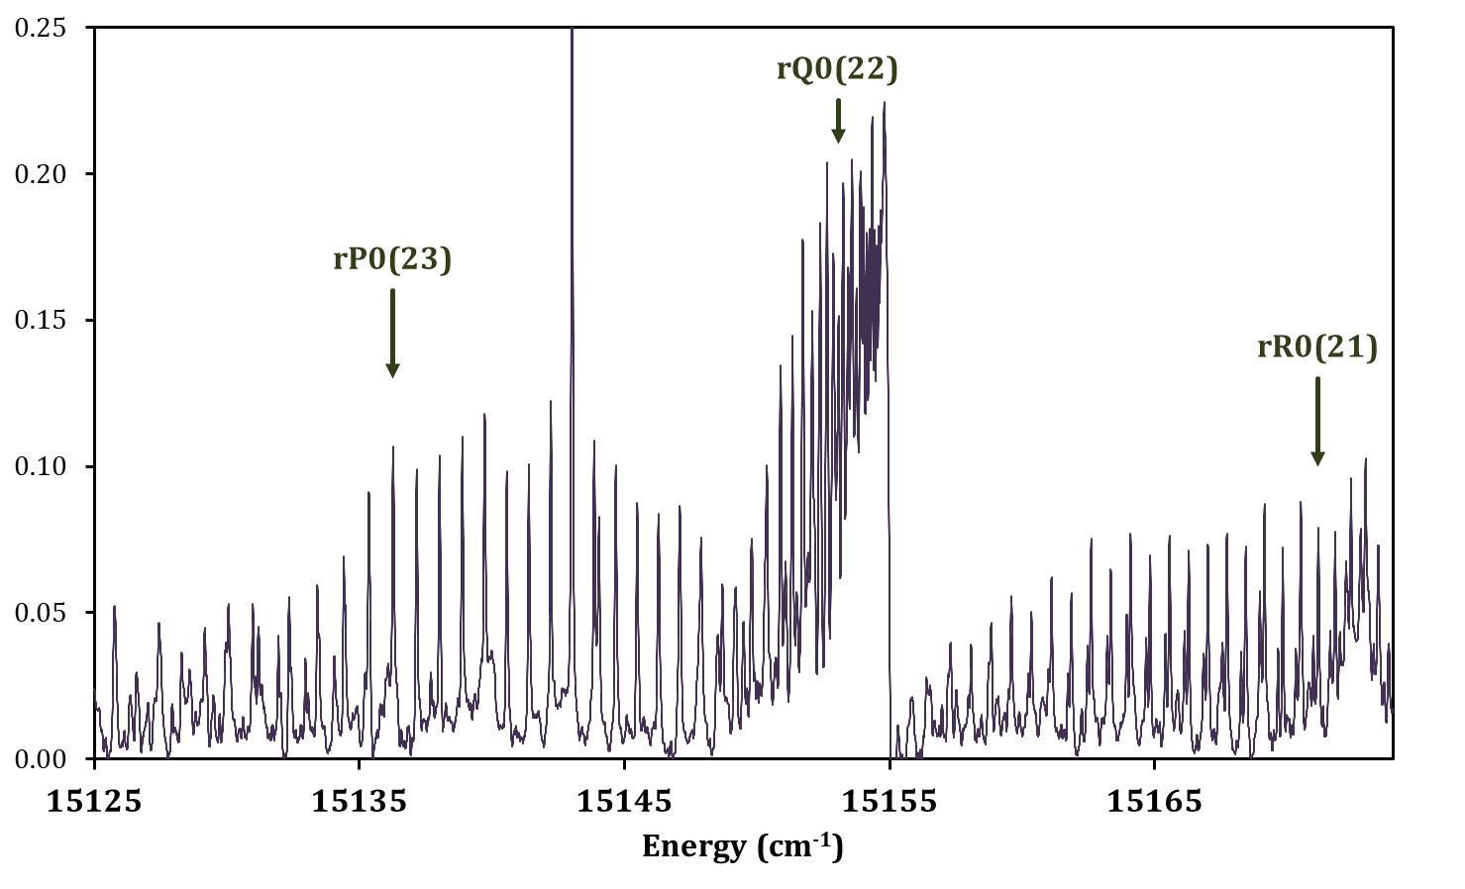
(1,0) Subband of ⁶³CuOH Transition
Absorbance

Slide 14
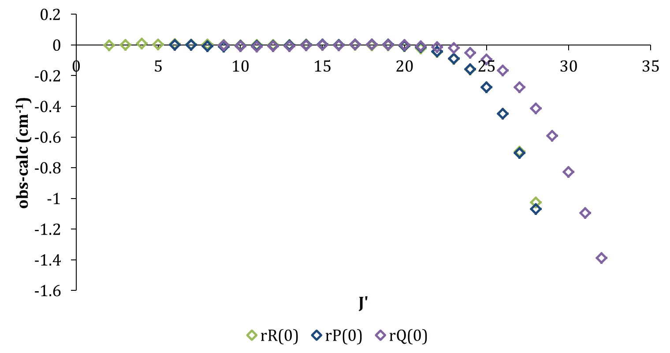
Residuals for (1,0) subband of ⁶³CuOH

Slide 15
CuF, calc
CuF, expt
CuOH, expt
CuOH, calc
Koukounas & Mavridis,
JPCA 112 (2008), 11235-50
Fu, Cao, Ma, & Bian,
RSC Adv. 6 (2016), 100568
Dufour, Schamps, & Barrow,
J. Phys. B 15 (1982), 3801-3818
Delaval et al.,
Chem. Phys. ,111 (1987), 129-139
Baltayan et al.,
Chem. Phys. 120 (1988), 123-129
Trkula & Harris,
J. Chem. Phys. 79 (1983), 1138
Jarman, Fernando, & Bernath,
J. Mol. Spec. 144 (1990), 286-303
Jarman, Fernando, & Bernath,
J. Mol. Spec. 145 (1991), 151-163
S. Wang et al.,
J. Chem. Phys. 123 (2005), 014313
20,000
B ¹Π
[20.3] ¹Π₁
˜
2 ¹A'
A ¹Σ⁺
[19.3] ¹Σ⁺
[19.0] C ¹A'
˜
[18.4] B ¹A"
(τ=612 ns)
1 ¹A"
17,500
b ³Π
[17.5] ³Π_{0,1,2}
Tao, Mukarakatem & Reid,
Chem. Phys. Lett. 449 (2007), 282
˜
1 ³A'
[15.9] A ¹A'
Energy (cm⁻¹)
[15.1] A"
1 ³A"
15,000
a ³Σ⁺
[14.6] ³Σ⁺
12,500
a ³A'
10,000
2500
μ_{a} = 4.542 (40) D
F. Wang & Steimle,
J. Chem. Phys. 132 (2010), 054301
μ_{a} = 3.968 (32) D
F. Wang & Steimle,
J. Chem. Phys. 134 (2011), 014303
X¹Σ⁺
˜
1 ¹A'
X¹Σ⁺
0
X ¹A'
Okabayashi et al.,
J. Mol. Spec. 209 (2001), 66-70
Whitham, Ozeki, & Saito
J. Chem. Phys. 110 (1999), 011109

Slide 16
Conclusions
CuOH transition at 15,100 cm⁻¹ rotationally analyzed
  Assigned as the [15.1] A" – X ¹A' transition
    Excited state suspected to be ³A" in character
  Obtained effective molecular constants for ⁶³CuOH, ⁶³CuOD, & ⁶⁵CuOH
    K_{a}' = 0 and 1 for CuOH, K_{a}' = 0, 1, and 2 for CuOD
  K_{a} = 1 rotational levels of [15.1] A" state of ⁶³CuOH perturbed at K_{c} > 21
    Perturbation suggests nearby state slightly higher in energy
r₀ structure for [15.1] A" state indicates a slightly shorter Cu-O bond, wider Cu-O-H angle, and unchanged O-H bond length relative to X ¹A' state
  Rotational constants (and resulting structure) inconsistent with limited computational data
Computational investigation of electronic structure of CuOH including low lying excited states of singlet and triplet multiplicity could provide valuable insight into the underlying nature of the observed electronic transitions
˜
˜

Slide 17
Acknowledgments
National Science Foundation
University of Missouri – St. Louis
Southern Illinois University Edwardsville
Thank you for your time!

