Slide 1
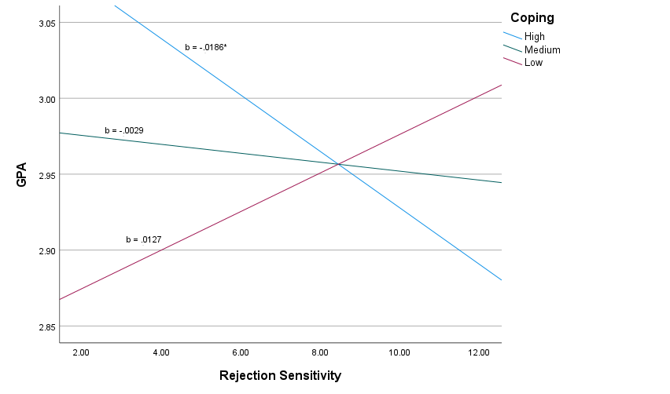
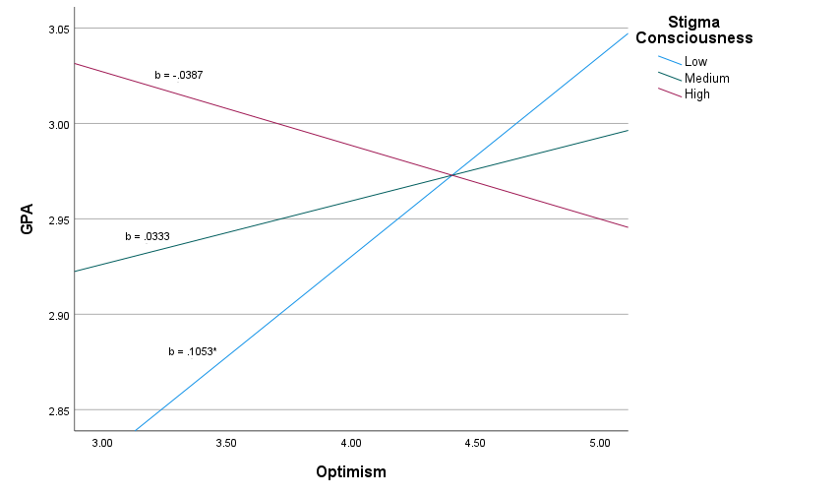
Successful Women Majoring in STEM Have Higher
Optimism and Lower Stigma Consciousness
Bridget C. Muise & Bettina J. Casad
University of Missouri-St. Louis
INTRODUCTION
METHOD
RESULTS
DISCUSSION
Academic Environments
Women are underrepresented in science, technology, engineering, and mathematics (STEM) education (Beede et al., 2011; Hill et al., 2010; Landivar, 2013).
Women role models in STEM courses have a positive effect on women students’ academic performance, engagement, and interest (Solanki & Xu, 2018).
Coping with Discrimination
Coping has a positive effect on adjustment to college life (Aspinwall & Taylor, 1992).
Rejection Sensitivity Based on Gender
Rejection sensitivity in women STEM students is higher in those who fluctuate in gender-STEM identity compatibility, which negatively affects academic performance. Lower performance is due to exposure to negative academic experiences and not social experiences (Ahlqvist et al., 2013).
Gender Stigma Consciousness
Women in STEM with higher gender stigma consciousness are more negatively affected in their academic motivation and well-being than women in non-STEM fields (Smith et al., 2007).
Optimism
Low optimism is significantly associated with high perceived stress and low academic performance in college students (Popa-Velea et al., 2021).
Participants
Women participants (N = 607) from varying racial backgrounds were undergraduate STEM major students from a non-clinical population and were recruited from a western University.
Procedure
Participants completed an online questionnaire using SONA Systems for course credit or $10. They self-reported levels of coping, rejection sensitivity, stigma consciousness, and optimism and Grade Point Average was collected from school records.
Data Analysis
All data analysis was run through SPSS v27 using PROCESS v4.0 (model 1).
Partially supporting hypothesis 1, results showed a significant 2-way interaction between rejection sensitivity and coping on GPA, F(3, 603) = 3.030, p = .0141, b = -.0186, R² = .0149, 95% CI [-.0260, -.0041].
Supporting hypothesis 2, results showed a significant 2-way interaction between optimism and stigma consciousness on GPA, F(3, 603) = 3.4048, p = .0060, b = .1053, R² = .0167, 95% CI [-.2220,-.0455].
Women STEM majors with higher gender rejection sensitivity had poorer academic performance despite having higher coping skills. This indicates that even with good coping skills higher fear of rejection for one’s gender had a stronger effect on the academic performance of women in STEM.
It must be noted that rejection sensitivity is not a personality trait, but a reactionary defense that stems from experiences of rejection in crucial developmental stages (London et al., 2007).
Because women are underrepresented in STEM, it is common for women to be aware of their gender and worry about gender-based rejection.
Women STEM majors with lower stigma consciousness had better academic performance with the presence of higher optimism.
Optimism seems to be a more significant indicator of better academic performance than coping skills.
Schools need to focus on lowering stigma consciousness by creating a more gender inclusive environment and fostering greater optimism in women students by having women role models in STEM careers.
This responsibility cannot rest fully on the student because school climate has a significant effect on academic performance (Daily et al., 2019).
Higher gender rejection sensitivity predicts lower GPA even with higher coping skills. Higher optimism predicts higher GPA, but only for women with lower gender stigma consciousness.
HYPOTHESES
Hypothesis 1:
Higher gender rejection sensitivity will predict lower Grade Point Average for women STEM students regardless of coping ability. Lower gender rejection sensitivity will predict higher GPA regardless of coping ability.
Hypothesis 2:
Stigma consciousness will moderate the relationship between optimism and Grade Point Average for women STEM students. For women with lower stigma consciousness, higher optimism will predict higher GPA.
ACKNOWLEDGEMENTS
This research was funded by the National Institutes of Health
Figure 1: Interaction among coping, rejection sensitivity, and GPA. *p < 0.05
Figure 2: Interaction among stigma consciousness, optimism, and GPA. *p < 0.05
Notes:
Coping: the ability to deal effectively with difficulties
Rejection sensitivity: The tendency to perceive social-identity threat
Stigma Consciousness: The extent to which people expect to be stereotyped by others

