Slide 1
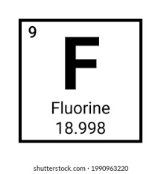
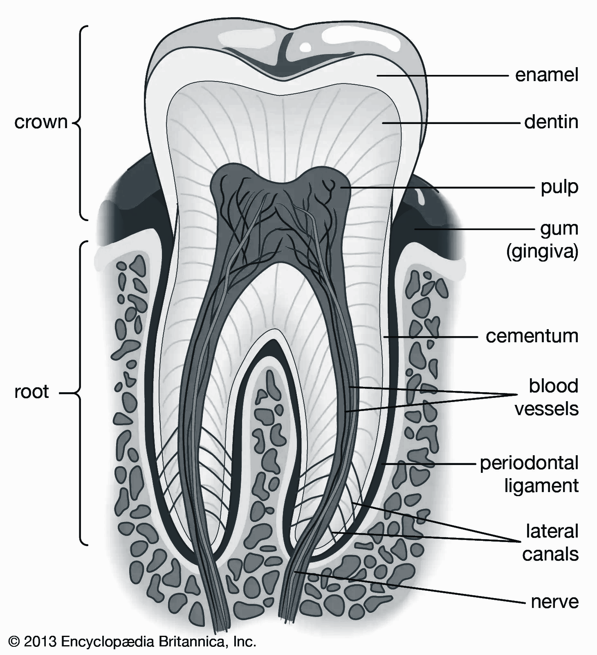
The Fight for Fluoridation in STL
By: Noor Yousaf | Advisor: Dr. Lesley Sieger-Walls, PhD
Abstract
Dr Ralph Rosen
Fluoridation is the addition of fluoride to a source of drinking water. In St. Louis’s public water supply, the amount of fluoride remains the same since 1953 at 5ppm. Dr. Ralph Rosen and his team of dentists and researchers advocated for the fluoridation of the water because it reduced the frequency of dental caries occurring in children and adults alike, but the public had opinions on the sudden addition of chemicals to their water. This includes how the public’s health will be affected, how consumer products would change, and also how effective this addition of fluoride would be. This debate was the beginning of the modern day debate and struggle to regulate the amount of certain chemicals in the U.S. drinking water, including lead, PFAS, and trihalomethane.
Graduated from WashU’s dental school
Concerned about the unregulated amounts of chemicals used to purity water.
1904 World’s fair– STL wanted the cleanest water to be on display
Regulation on chemicals was not legally defined
Wanted to make STL water supply healthier and better regulated
Head researcher on benefits of fluoride
Citations
Amos, James K. “Policity of the Division of Health of Missouri on Fluoridation of Public Water Supplies.” Division of Health of Missouri, 1952.
Carroll, Boyd F. “Anheuser-Busch Adviser Opposes Fluoridation.” St. Louis Dispatch, February 4, 1952, p. 3.
Rosen, Ralph. “Letter to Dr. O’Brien asking for further details of the ‘Wait and See’ Policy.” January 25, 1952.
McCarthy, Dennis. “Purely Personal.” Cartoon. Sunday Enterprise, March 9th 1949.
United States of America v. Mytinger & Casselberry, INC., et al, Ben Harrison, p. 6, United States District Court for the Southern District of California Central division, 1951.
Research on Fluoride
Controversial Conclusion
Pro Fluoridation Efforts
Anti Fluoridation Protests
Rosen surveyed areas around STL and if the water supply already had fluoride in it naturally or not.
He noticed that cities with fluoride in their water had lower frequencies of dental caries and other oral diseases
He said fluoride would have to added at at least 1 part per million (ppm)
It was here that Rosen realized the importance of regulating the chemicals in drinking water
Rosen and his team advocated to the Missouri government to add fluoride to public water supplies.
Published numerous articles and studies stating the benefits
Reduced dental caries by 68%
Children 5-14 years would have most benefits if fluoride is consumed in these years
Only 1 ppm of fluoride would be added at a minimum
Once the papers were publicly published, there was major uproar
Anheuser–Busch
Large national beer brewing company in STL
Funded anti-fluoridation efforts
The general public saw fluoridation as mass medication and were outraged
The public called for more regulation on such chemicals
In the end, STL’s public water sources were all fluoridated by the end of 1953.
The amount of fluoride in the water has remained constant at 5 ppm.
Many civilians began an uproar, calling the movement “mass medication”
Since then, there’s been a lot of efforts into watching what companies and the government put into the water
Pfas is now being more heavily recorded since some water sources in many cities have more than the legal limit of pfas to water
Notes:
Dr. Rosen:
2nd point: This actually goes back to the St. Louis World’s Fair in 1904. For preparation for the fair, the government officials were concerned about how nasty and disgusting the brown water in STL looked in the fountains. As a result, they hired a group of water purification scientists to come up with a chemical formula that would not only cleanse the water but also make it crystal clear. Unfortunately, this meant that these scientists had full reign to do whatever they wanted with the water including adding ludicrous amounts of toxic chemicals to the public water supply. As a result, years later when Rosen had finally graduated, he was concerned about how much of the toxins were in the water and not regulated.
3rd point: He wanted some way to both simultaneously make the water nutrient rich again while also putting an end to unregulated water contamination. He began a research from his Dental School days over an element called fluoride. (SHOW FLUORINE PIC). In this research, he surveyed some areas around STL to see how the amount of fluoride naturally in the people’s drinking water affected the frequency of them getting dental caries (cavities). He noticed that those who had some amount of fluoride in the water had less likelihood in both childhood and adulthood to experience dental decay and oral diseases. Thus, he became the head researcher on the other benefits of fluoride.
Research:
1st point: Here, he noticed that cities that had fluoride already in their water systems had a lower frequency of people getting dental caries. This in turn, he realized, led to less spending on cavity fillings and tooth extractions within children and adults alike. He then took to his labs and studied the effects fluoride had on not only tooth enamel but also the tooth anatomy as a whole.
2nd point: During his studies, Rosen concluded that for fluoride to have a decent effect, it would have to be present at 1ppm but less than 10ppm to prevent fluorosis– a condition where the bones in your body begin to weaken as a result of overexposure to fluoride. This steady balance HAD to be maintained by the STL water supply system or else the people would be in danger.
Pro Fluoridation:
1st point: After so much thorough research done on Fluoride and the effects of it on human dental health, they concluded that it was quite beneficial to adults and children alike.
2nd point: Within limited amounts of fluoride consumption, Rosen and his team found that there was a significant decrease in dental caries in the general population (Read point).
Fluoride works when it’s accumulated into the human body. The earlier one consumes a safe amount of fluoride, the more protection they’ll receive in their adult life. Adults still receive these benefits, but not as much as the children who consume it before them.
Anti-Fluoridation:
1st point: It was mainly the public that was having issues with these recent studies and addition without their knowledge or opinion to vote on it.
2nd point: Anheuser-Busch is a large national and international beer brewing company that started here in STL. The reason they were against it was because they did not want their yeast fermentation and corn milling to be negatively affected by the new addition of fluoride into STL waters. They needed as pure of water as they could get, so the science behind how it would affect their brewing business caused them to fund for anti-fluoridation efforts!
3rd point: Fluoride was not yet determined to be an essential nutrient for human health and diet by the FDA. As a result, there were multiple court cases that filed against the addition of fluoride to STL waters in fear that it would be a wholly unnecessary ordeal that would do more harm than good.

