Slide 1
Bank Failures and Financial Crises: A Tale of Two Countries
Sarah Boslaugh
UMSL Undergraduate Research Symposium
28 April 2023

Slide 2
How Does Banking Work?
Banks accept deposits (on which they pay interest) and make loans (on which they collect interest)
In the old days: 3-6-3
Deposits are used to make loans and to make other investments, with returns above the interest they pay depositors
Most deposits can be withdrawn at any time
Notes:
Fun fact: Federal Reserve set reserve requirement at 0 on March 15, 2020
Days of the 3-6-3 rule of the 1950s-1970s long gone: banking deregulation in the 1980s removed ceiling on interest rates

Slide 3
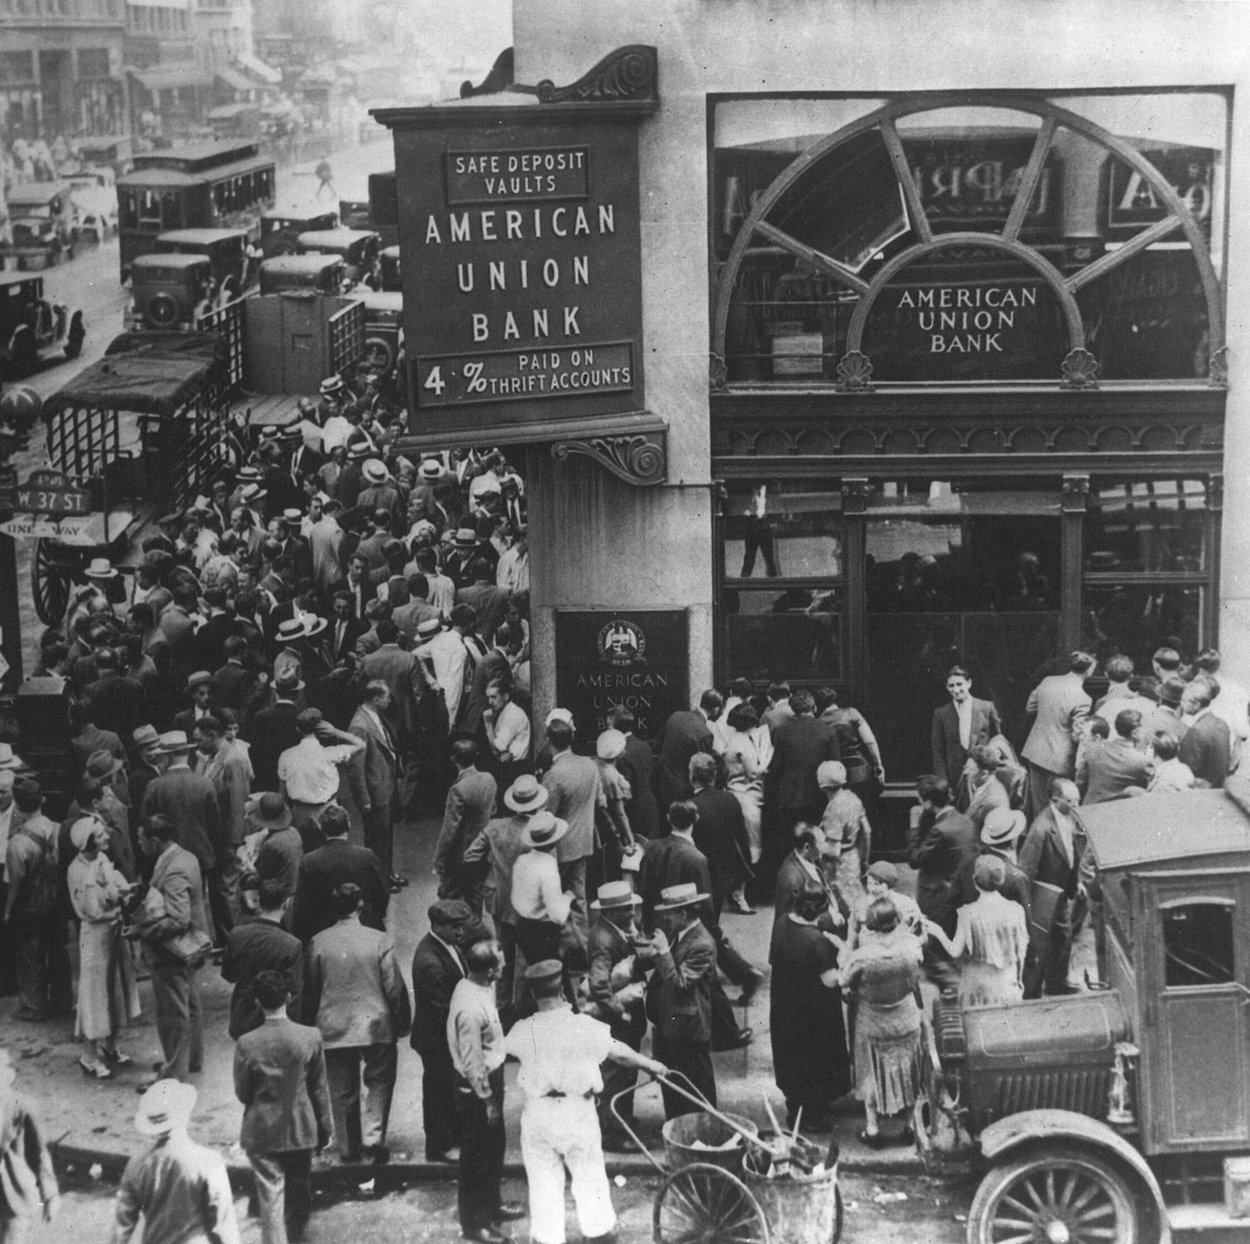
If everyone wants their money back at once…
You get a bank run, which can spread to other banks, causing a widespread panic
Depositors outside American Union Bank, New York City, April 26, 1932
Public domain image from Wikipedia Common

Slide 4
Remember the 2007-2008 financial crisis?
In the U.S.:
  Collapse of the housing bubble/value of mortgage-backed securities
  Lehman Brothers bankruptcy on Sept. 15, 2008
  Federal government bailout
  Set off worst recession since the Great Depression
5 of the 6 other G-7 countries had a similar experience
Meanwhile, in Canada:
  No bank failures
  No government bailout
  Only a mild recession (less severe than those of the early 1980s or 1990s)

Slide 5
Bank panics are a recurring feature of the American financial system
18th century: panics in 1792, 1796-77
19th century: panics in 1837, 1839, 1857, 1884, 1873, 1890
20th century: panics in 1907, 1929 (Great Depression)
FDIC created in 1933 to restore confidence in the banking system
  Insures deposits up to a set amount (currently $250,000), so no depositor under that amount will lose funds if a bank fails
Yet FDIC failed to prevent 2007-2008 crisis (which required a major bailout)

Slide 6
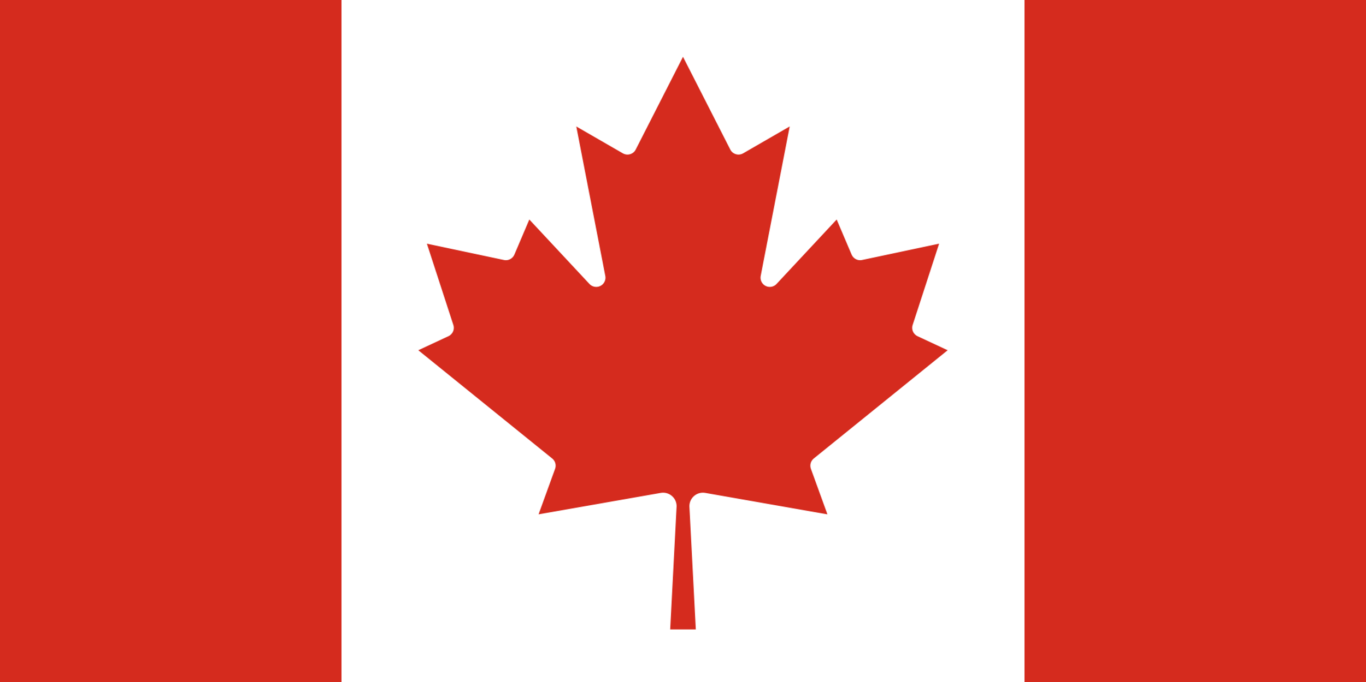
Meanwhile, north of the border…
The Dominion of Canada created in 1867 by the British North America Act (Dominion within the British Empire)
  Move to independence from UK: Canadian Citizenship Act (1946), Canada Act (1982)
Canada and the U.S. have a lot in common, yet Canada has never experienced a bank panic
Why?

Slide 7
Reminder: Humans* are often over-confident in their ability to predict the future
*Or economists are, anyway, according to Mervyn King, Governor of the Bank of England (2003-2013)
Like everyone else, bankers respond to incentives:
  A “heads I win, tails you lose” system encourages risky behavior by removing the consequences of failure
King argues that the banking system should be structured to counteract this tendency, not reinforce it

Slide 8
Could differences in the structure of the banking system create differences in incentives?
Could these differences explain the observed difference in outcomes?

Slide 9
Canadian banking system: Overview
  Federal government grants charters/regulates banks
  Nationwide system of branch banking
    2013: 6 largest banks hold 93% of the market share
  Explicit requirements for capital, double liability for shareholders
  Single federal entity* regulates many types of financial institutions, including banks, mortgage lenders, insurance companies
  Canadian Bankers Association (private consortium) guarantees deposits and takes over failing banks
  *OFSI: Office of the Superintendent of Financial Institutions

Slide 10
American banking system: Overview
Banking regulated at the state level (U.S. Constitution)
Branch banking often prohibited across state lines, sometimes within a state, resulting in many small “unit banks”
  Small local banks tended to be undiversified, vulnerable to shocks like crop failure in a region
  U.S. had over 31,000 banks in the early 19th century, almost 7,000 in 2013
Regulation highly fragmented and inconsistent, making reporting and supervision difficult
  2007-08 crisis: no adequate statistics to evaluate the system as a whole

Slide 11
Typical mortgages in the U.S. and Canada
U.S.: fixed rate over 30 years
  Interest rate risk motivates creation of mortgage-backed securities (MBS)
  Over half of U.S. mortgages securitized in 2000
  Risk passed to MBS holder, encouraging risky lending
Canada: 25 years, financing renegotiated every 5 years
  Lower interest rate risk, less motivation to securitize mortgages
  About 10% of Canadian mortgages securitized in 2000
  Risk remains with the bank, encouraging prudent lending
  Stricter regulation regarding down payments, mortgage insurance

Slide 12
Conclusion
Differences in outcomes are due primarily to differences in how banking is structured and the resulting incentives
Canada: centralized system, effective regulation
  Good outcomes: subprime mortgages are rare, home ownership slightly higher than in U.S., borrowing costs and rates of return on equity comparable to the U.S.
U.S.: fragmented system of banking based on founding fathers’ distrust of centralized power
  Reform of the basic structure would require a Constitutional amendment
  Current system of fragmented regulation is serving some people’s interests, also unlikely to change

Slide 13
References
Bordo, Michael B., Angela Redish, and Hugh Rockoff. “Why Didn’t Canada Have a Banking Crisis in 2008 (or in 1930, or 1907, or…)?” National Bureau of Economic Research, 2011. NBER Working Paper 17312.
Haltom, Renee. “Why Was Canada Exempt from the Financial Crisis?” Econ Focus, Fourth Quarter 2013, pp. 22-25.
King, Mervyn. The End of Alchemy: Money, Banking, and the Future of the Global Economy. Norton, 2016.

Slide 14
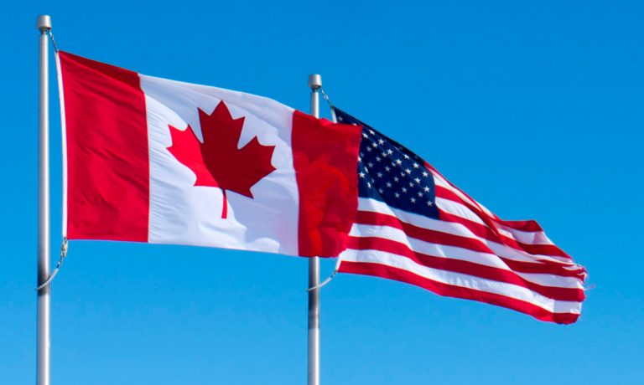
Questions?
This Photo Public domain image from The Creative Commons. CC BY-SA-NC

