Slide 1
Characterizing border associated macrophages during spinal cord regeneration
Addison Vogt
Mokalled Lab
Washington University School of Medicine

Slide 2
Spinal Cord (SC) impairments result in motor and sensory impairments
Regeneration
Mammals have limited regenerative ability
Spinal Cord Injury (SCI)
Further Injury
Chronic immune response can cause secondary injuries and inflammation
Paralysis
Mammalian SCI often results in paralysis
Graphic from Biorender

Slide 3
Zebrafish have advanced regenerative ability
01
The SC is injured
02
Glia bridge across the lesion site, connecting the two sides of the SC
03
Neurons branch over the glial bridge, inducing full recovery of the SC
Graphic from Mayssa Mokalled

Slide 4
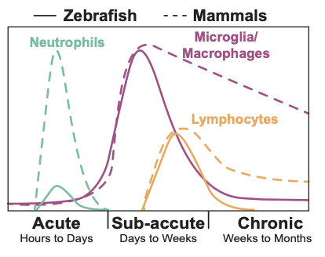
Immune response after SCI differs between mammals and zebrafish
Immune activation following SCI is necessary to provide a permissive environment for tissue repair
Mammals have chronic persistence of immune cells following injury
Zebrafish have full immune cell clearance after 48 days post SCI
Graphic from Dana Shaw

Slide 5
Border Associated Macrophages (BAMs) are specialized immune cells
Macrophages
Ms
Immune cells that help repair and regenerate tissues
Border Associated Macrophages
specialization
A subgroup of specialized macrophages that aid specifically in formation and repair of the blood brain barrier (BBB) and blood spinal cord barrier (BSCB)
BAMs
Zeng, 2023

Slide 6
Hypothesis
Hypothesis: BAMs in zebrafish are necessary for regeneration of the BSCB, driving immune clearance following SCI
Graphic from Dana Shaw

Slide 7
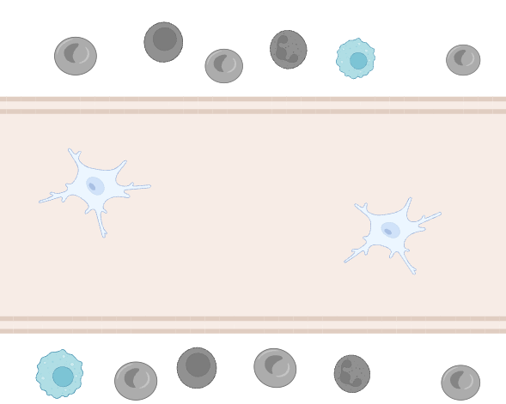
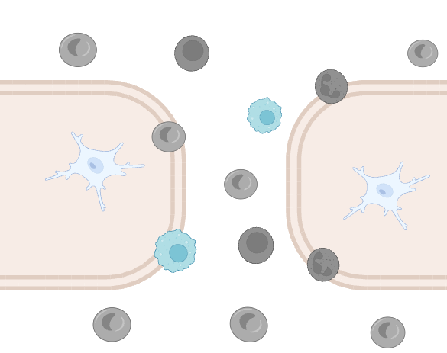
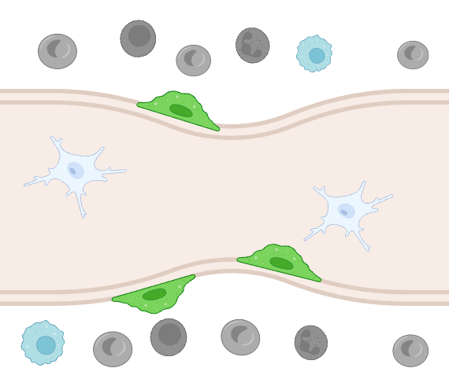
Hypothesis: BAMs in zebrafish are necessary for regeneration of the BSCB, driving immune clearance following SCI
Blood-resident immune cells
Macrophages
Microglia
BAMs
01
Healthy SC
02
Injured SC
01
Recovering SC
Graphic from Biorender

Slide 8
Methodology
1
4
“snRNA-seq”
BSCB assays
Sequencing of the pre mRNA in each individual cell
Dye injections to visualize the repair of the BSCB
BSCB ablation
2
5
Transcriptomics
Ablating BAMs to confirm they are required for regeneration
Developing a gene list for distinguishing markers of BAMs
3
6
Hybridization Chain Reaction (HCR)
BAM-specific lines
Staining for cell types using DNA probe pools
Using our identified genes to create transgenic lines
Notes:
Single nuclear RNA sequencing

Slide 9
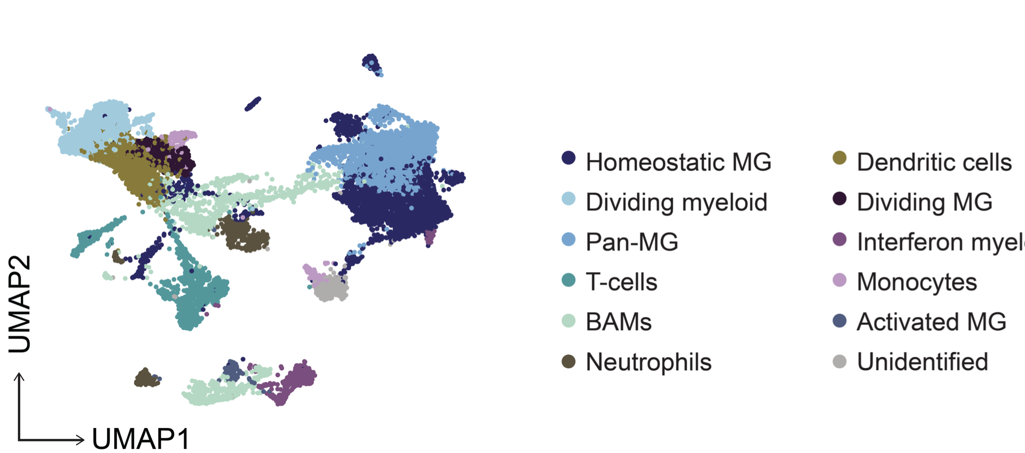
snRNA sequencing identified a population of BAMs
Data from Lily Zhou & Vishnu Muraleedharan Saraswathy

Slide 10
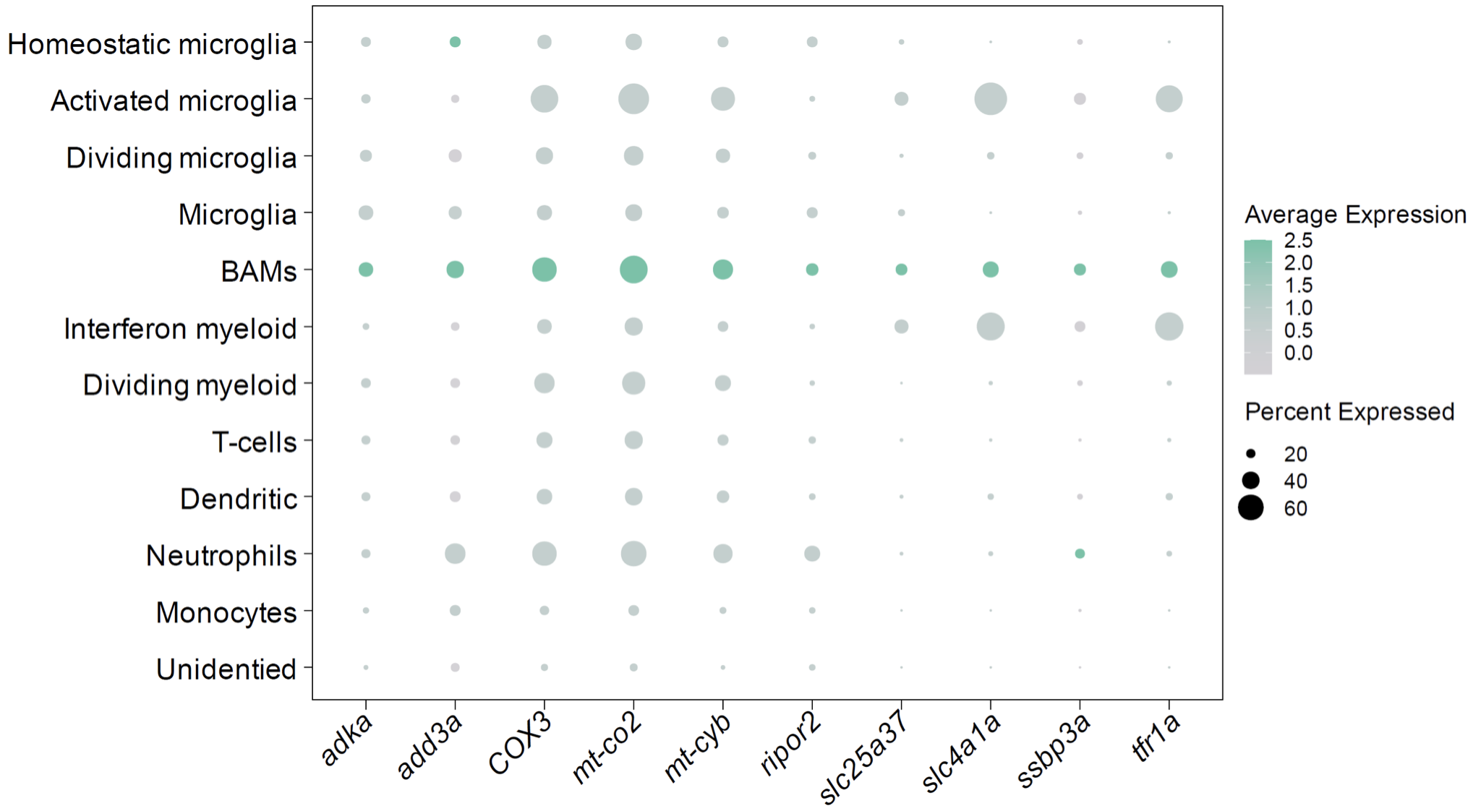
Six genes were identified as BAM markers
Identification
Gene Ontology (GO)
Probe Creation
Identifying BAM markers through our database
Analyzing common functions related to the marker genes
Using the sequences of putative markers to create probes

Slide 11
HCR labels gene sequences using DNA probes and amplifiers
Graphic from Biorender

Slide 12
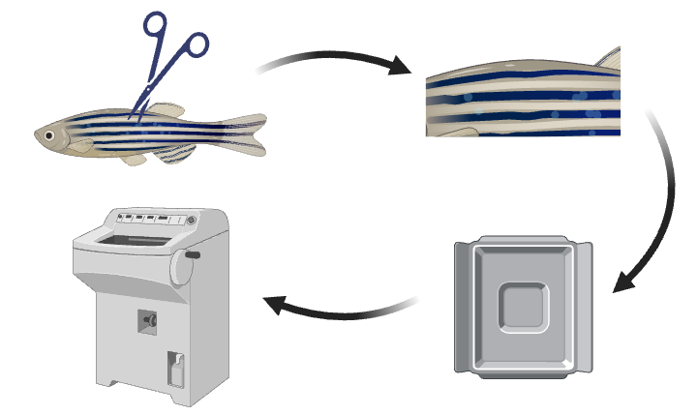
SCs are collected and prepared for staining
1
2
Spinal cord surgery
Tissue collection (3, 5, 7dpi)
Embedding
Tissue sectioning
4
3
Graphic from Biorender

Slide 13
DNA probes are used to label SC tissue sections
adka
AMP salvage, AMP biosynthetic process, purine ribonucleoside salvage
cox3
Mitochondrial electron transport, cytochrome c to oxygen
mt-co2
Electron transport, oxidative phosphorylation
nfic
DNA replication, regulation of DNA transcription, DNA metabolic processes
slc4a1a
Carbon compound transport, regulation of intracellular pH
slc25a37
Iron import to mitochondrion, iron ion transport, erythrocyte maturation
Graphic from Biorender

Slide 14
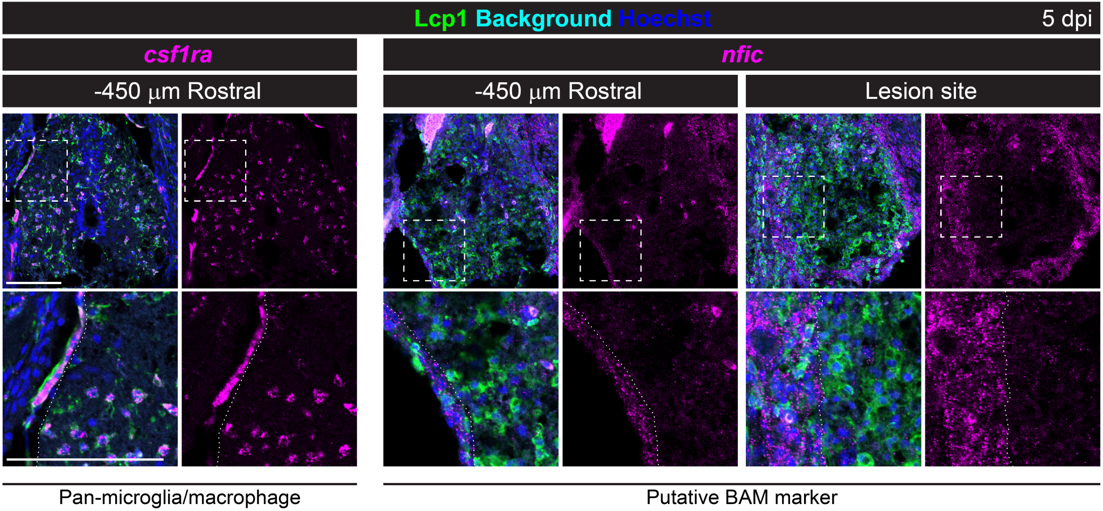
HCR results show nfic as a potential BAM marker

Slide 15
Dye is injected to observe the permeability of the BSCB
Fluorescent dye
1 hour
Graphic from Biorender

Slide 16
MG and MF are ablated, determining their necessity for SC repair
MG/MF ablation
Fluorescent dye
1 week
Graphic from Biorender

Slide 17
BAM promotor is developed to deplete BAMs
Graphic from Biorender

Slide 18
Zebrafish BAM promoters are transferred into mice
Zebrafish
Mouse
Naturally occurring BAM-promoter
Transgenic BAM-promoter
Graphic from Biorender

Slide 19
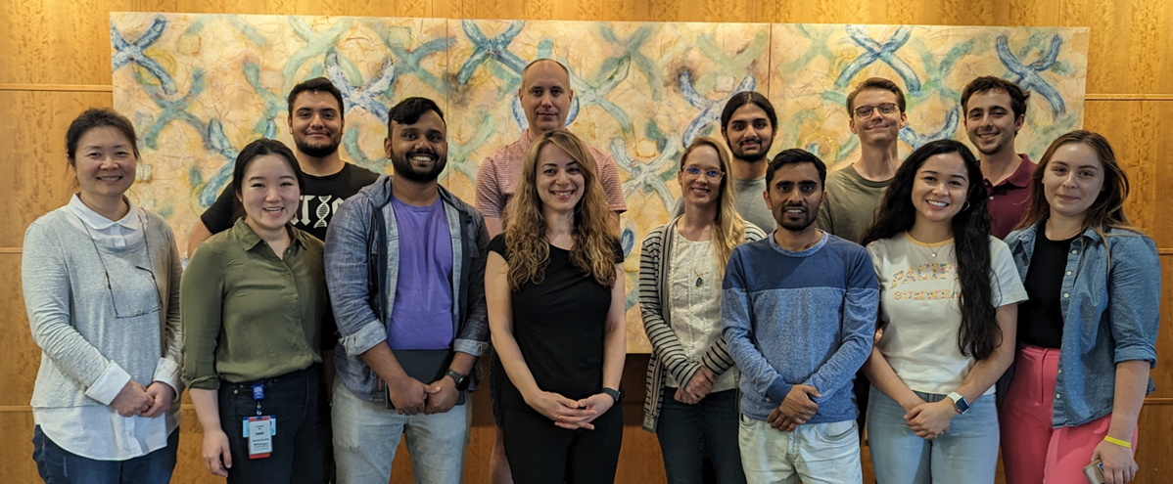
Acknowledgements
Mokalled Lab
Mayssa Mokalled, PhD
Miguel Dominguez
Micklaus Garcia
Paresh Hejmadi
Yana Honcharok
Ritika Jagarlamudi
Nick Jensen
Ryan McAdow
Ridim Mote, PhD
Catrina Reyes
Vishnu Saraswathy, PhD
Dana Shaw, PhD
Chase Weinholtz
Hunter Yamada
Lili Zhou, MD/PhD

